Slide 1

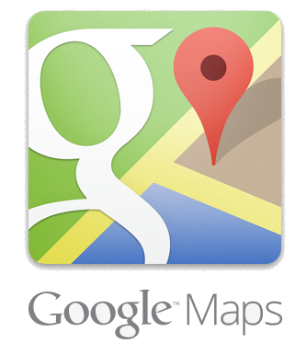






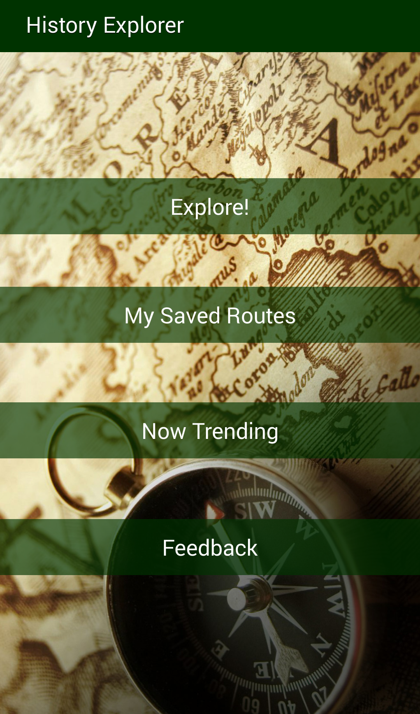
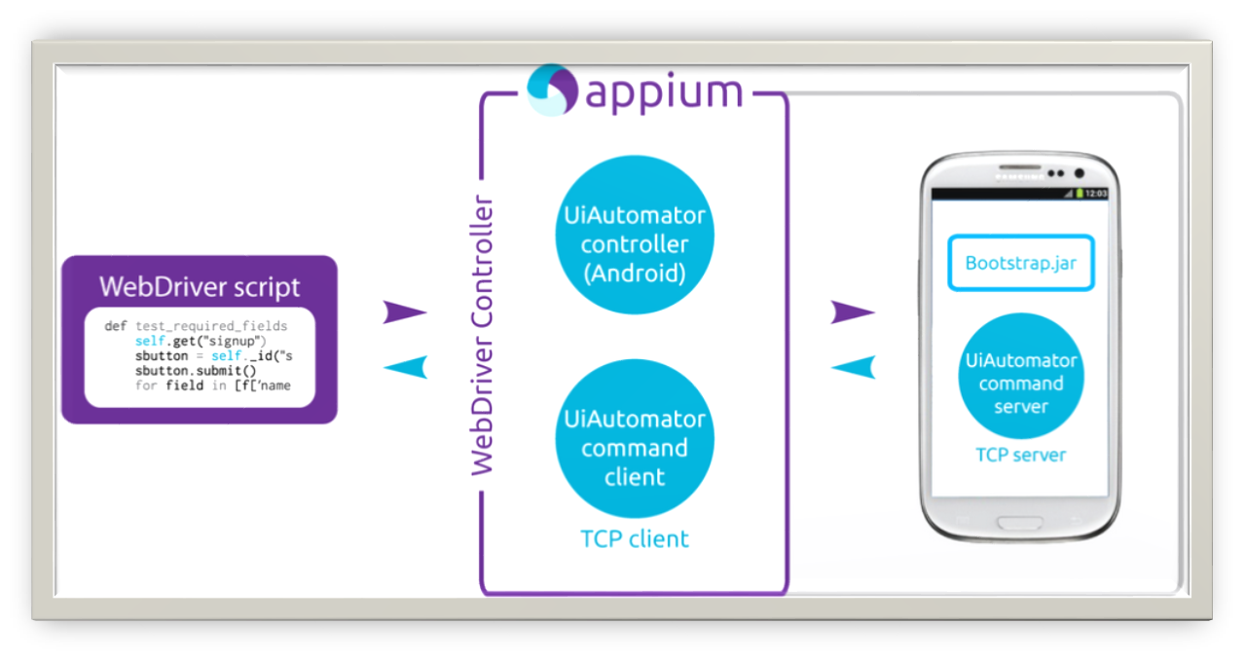
School of Computing & Information Sciences
Senior Project, 2014, Fall
History Explorer
Student: Yesenia Yser, Florida International University
Mentor: Tracy Beeson, Historian
Instructor: Masoud Sadjadi, Florida International University
1
Problem
According to National Assessment of Education Progress completed in 2011 on fourth, eighth, and twelfth graders, an average of 16% of these students were proficient on American history.
Due to standardized test, American schools are devoted less time on history and are more focus on reading and mathematics. Since students are hardly tested on history, less emphasize is placed on student’s understanding of history.
8
Screenshots
2
Current System
Technology has shown to either distract or motivate an understanding of a specific subject for any age.
History Explorer application incorporates the ability to navigate to a specific location, create route of selected locations, and retrieve media files, such as published documentation, audio files, and image, about a specific location.
All documentation and audio files are created and uploaded by the web admin, Tracy Beeson. These media files will be reliable sources of historical data providing History Explorer users with verifiable and accurate historical information on any historical location they desire to visit.
5
Object Design
4
System Design
3
Requirements
The system shall…
Allow users to search for a historical place of Interest
Allow user to select a historical place of Interest
Allows users to play media file for the selected sites
Allows users to generate route of selected places of interest
Allow users to submit feedback to the application admin
Allow admin to create a historical place of interest
Allow admin to edit a historical place of interest
Allow admin view email from the users
Allow user to submit a feedback to the admin
Allows the system to autofill historical place of interest information
Allows the user to add a Timeline based information on the historical place
7
Verification
Appium framework, a Selenium WebDriver protocol wrapper was used to run test automation on Android Applications.
Test Case ID
Purpose
Test Setup
Input
Expected Output
Actual Output
9
Summary
6
Implementation
My contributions:
The Model-View-Controller (MVC) architectural pattern was used for the development of the Android Architecture.
- PHP: object-oriented programming language used for controllers and views
- Android: a mobile operating system based on Linux kernel and currently developed by Google.
- SQL & MySQL: query language and DBMS client tool used to view and manipulate database
Acknowledgement
I am thankful for the help that I received from my group member, Ariel Diaz.

